Slide 1


Algorithm
=============================================================================
WWW.THEMLLABS.COM || contact@themllabs.com || Phone : 91-7338339898, 91-6362546088

Slide 2
Agenda
Algorithm
Types of algorithm
Supervised learning
Unsupervised learning
Semi supervised learning
Reinforcement learning
=============================================================================
WWW.THEMLLABS.COM || contact@themllabs.com || Phone : 91-7338339898, 91-6362546088

Slide 3
Algorithm
An algorithm is a procedure that run on data to create a model.
The algorithms in ML or DL are same as any algorithm in computer science
It performs pattern recognition and also fit on the dataset.
Models are the output of algorithms in ML or DL
=============================================================================
WWW.THEMLLABS.COM || contact@themllabs.com || Phone : 91-7338339898, 91-6362546088

Slide 4
These algorithms can be described using math and pseudocode.
These algorithms efficiency can be analyzed and described.
The algorithms can be implemented using any of the high level language.
Examples of ML algorithms are Linear regression, Decision trees, K-Means etc.
=============================================================================
WWW.THEMLLABS.COM || contact@themllabs.com || Phone : 91-7338339898, 91-6362546088

Slide 5
Types of algorithm
The algorithms can be divided into categories based on their purpose. The main categories are:
Supervised learning
Unsupervised learning
Semi-supervised learning
Reinforcement learning
=============================================================================
WWW.THEMLLABS.COM || contact@themllabs.com || Phone : 91-7338339898, 91-6362546088

Slide 6
Supervised learning
In these type of algorithms, the human will act as expert/teacher.
The inputs and the outputs for that (labels) are provided, the computer have to find the patterns or learn from the data.
The algorithms will predict the output based on the relationship or patterns it learnt in the training.
Examples, Linear regression, Decision tree, SVM etc.
=============================================================================
WWW.THEMLLABS.COM || contact@themllabs.com || Phone : 91-7338339898, 91-6362546088

Slide 7
Unsupervised learning
In these type of algorithms, the human or experts will not be there.
The machines or computers are trained with unlabeled data.
The computer has to find the patterns and it will teach you new things after learning the data.
=============================================================================
WWW.THEMLLABS.COM || contact@themllabs.com || Phone : 91-7338339898, 91-6362546088

Slide 8
These algorithms mainly used in pattern detection and descriptive modelling.
These algorithms will mine the data to find the rules, detect patterns, Summarize and group the data points.
The examples are, K-means clustering and Association rules
=============================================================================
WWW.THEMLLABS.COM || contact@themllabs.com || Phone : 91-7338339898, 91-6362546088

Slide 9
Semi supervised learning
These type of algorithms falls between supervised and unsupervised learning algorithms.
These algorithms are best for model building for those who have absence of labels in many observation and presence of label in few observation.
=============================================================================
WWW.THEMLLABS.COM || contact@themllabs.com || Phone : 91-7338339898, 91-6362546088

Slide 10
Reinforcement learning
Reinforcement learning algorithms (or agent) will learn continuously from the environment iteratively.
These algorithms will take actions that would maximize the reward or minimize the risk.
Examples are, Q-Learning, Temporal Difference, Deep adversarial Networks
=============================================================================
WWW.THEMLLABS.COM || contact@themllabs.com || Phone : 91-7338339898, 91-6362546088

Slide 11
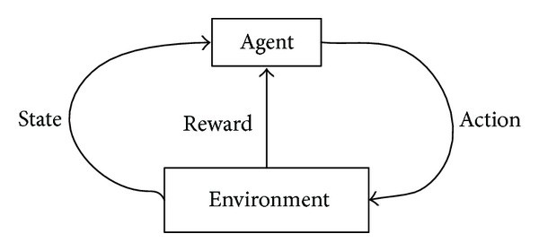
The relationship between agent and environment in reinforcement learning is shown in the figure.
Computer playing Chess, self driving cars and robotic hands are applications of reinforcement learning algorithms.
=============================================================================
WWW.THEMLLABS.COM || contact@themllabs.com || Phone : 91-7338339898, 91-6362546088

Slide 12
Thank you
=============================================================================
WWW.THEMLLABS.COM || contact@themllabs.com || Phone : 91-7338339898, 91-6362546088

